Slide 1
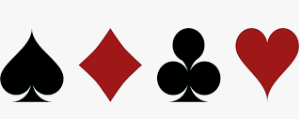
CARDGAMES.ORG
Welcome to
Card Games with Leaderboard and Online option
http://cardgames-seniorproject-node.herokuapp.com/
Zachary Kuchar

Slide 2
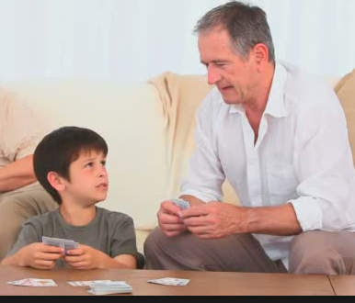
My inspiration…
My grandfather got me interested in card games when I was younger
Later on, I enjoyed playing computer/video games
When a class project involved me creating a Crazy Eights game, the opportunity presented itself to put the two together and create a Website full of card games.

Slide 3
Aesthetics and Functionality
I used HTML, CSS, Javascript, Node.js, GIT, mLab, and Heroku
In this project I included:
multiple games, graphics, and animation
a database to record users names, passwords, and scores.

Slide 4

Layout and Design
I started with Crazy Eights since I had code started from a previous project.
Using that as the foundation, I added Blackjack, Go Fish, War, Spider Solitaire, and Matching games.
I chose Snip Snap Snorum because it peaked my interest

Slide 5
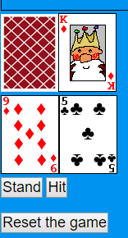
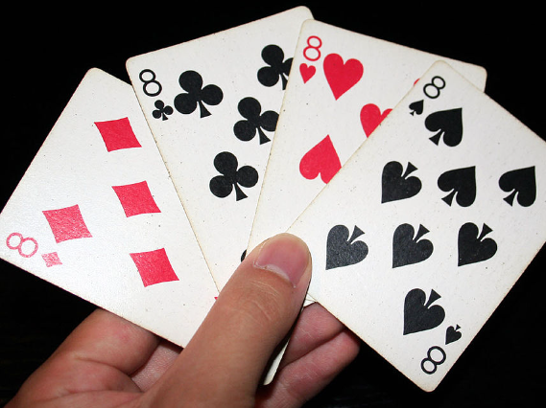
The Creation
I had the initial layout for Crazy Eights. This gave me the
foundation to build the other games.
I updated the computer play making it a harder game.
Next, I added Blackjack. The player had control of what to do with two buttons.
The game kept track of the card’s values in both hands. When the value was over 21, the player would bust and lose. At the end of the game, the player with the higher value won.

Slide 6



The Creation of Snip Snap Snorum
Snip Snap Snorum was an additional game that I found online. This was interesting because I had never played it before.
The first card played can be anything, but the second and third cards must match the value of the first card played.
Playing a third card allows for you to start the next round. If you do not have a legal card to play, you must pass the turn. The computer proceeds to play until it no longer has a legal card.
Snip Snap Snorum

Slide 7
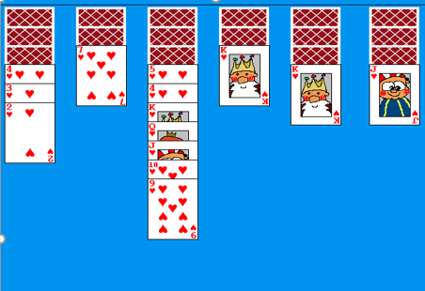
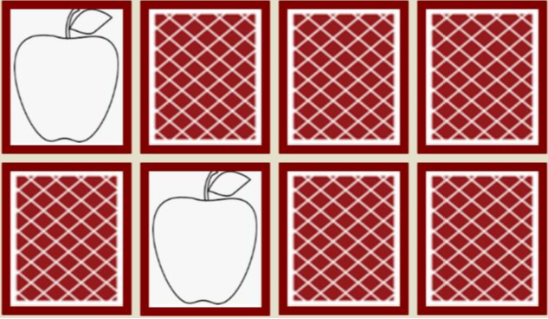
Spider Solitaire - Matching – War Games
Spider Solitaire required a click on a card
and a click on the row you want it moved to.
When the row of cards contained the correct
order, the cards would be removed, and the
player is awarded a point
Next, I added and easy picture matching game.
The object was to match all the cards in as few
moves as possible.
Last, a simple War game, This only required the
player to hit a button to battle against the computer. The
higher valued card would score a point
After the deck of cards had been dealt, the score
was added to the leaderboard.

Slide 8
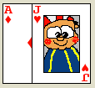

Challenges - first with Blackjack
The Ace: Incorporating both values of one and eleven.
After testing, I settled on the value of eleven and
subtracted ten if the total hand value went over twenty-one.
Next was the values: Calculating the values of the cards was time consuming.
I had an issue with the way the values were being concatenated together.
Example: 7+3 displayed 73, instead of 10. I found my mistake.
I added a “+” in front of the
values to be added.

Slide 9

Snags with Go Fish
I restructure the game, since I discovered that the original set of rules were different from my version. Discarding 2 pairs instead of 4 cards.
Issue with asking and receiving cards, and making sure the user could not play extra cards.
Fix:
I set up a Boolean variable to determine if the player needed to ask for a card or give a card to the computer.
This allowed the game to determine the necessary action for the player to take.

Slide 10
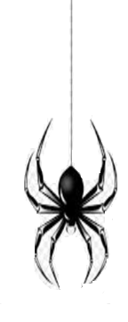
Spider Solitaire - card position obstacles
The position, and functionality of the card movement, was a challenge
– making the position absolute, I could displayed them vertically
A two-click system corrected the problem. First click selected the card/cards to be moved, the second found the new row position, if valid.
Moving a king and other cards to an empty row and removal of the ordered row of descending cards took some work.
Displaying an empty-card image with a title value of “empty”, the game could determine if the move was legal.
Removing a row, required verification of the cards order. If yes, the cards were removed otherwise, nothing happened.

Slide 11
Node.js - Setting up the Server
Online functionality required a Node.js project to be set up with WebSockets.
Learning how to run a node server with Websockets under Heroku for the webpage to add the necessary required files took time to figure out
I needed to change the way the WebSocket on the client end finds the server. Heroku’s forums suggested this code to allow my webpage
to interact with my server properly.

Slide 12
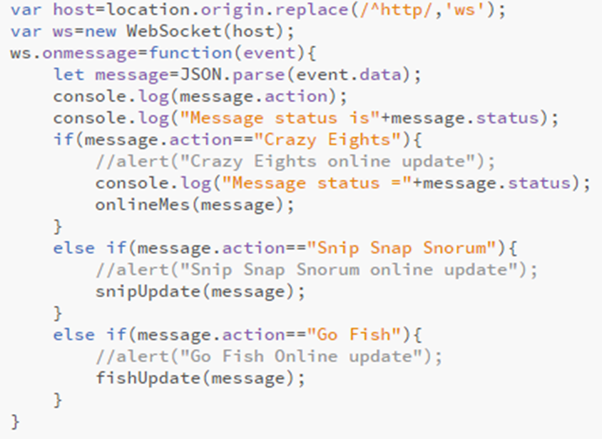
Setting up Online mode for games
When online, a message is sent to the
webpage, it checks to see which game
is being played. It returns the message
and updates to the game.
A button was added to toggle between
modes for each game.
Controls were set up to call new functions while online
Since we are using the online presenter class now buttons and card clicks now called different functions

Slide 13
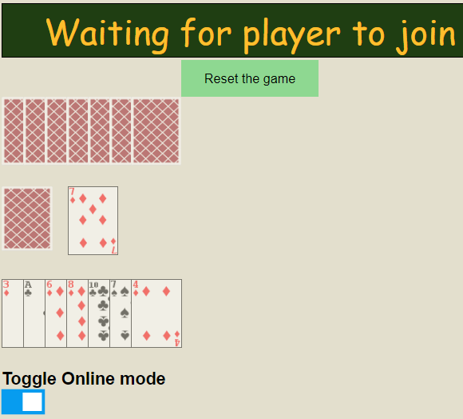
Online Mode - Crazy Eights
For Crazy Eights, the game notifies the server to see if a card is being played or drawn. The server replies back confirming the action.
Card hands are updated on the client side with the correct information
When Animations were added the card to run animations on was also a part of this animation

Slide 14

Online Mode – Snip Snap Snorum
Snip Snap Snorum did not require as frequent updates.
Only when passing the turn to the other player
This was changed when Animations were added

Slide 15
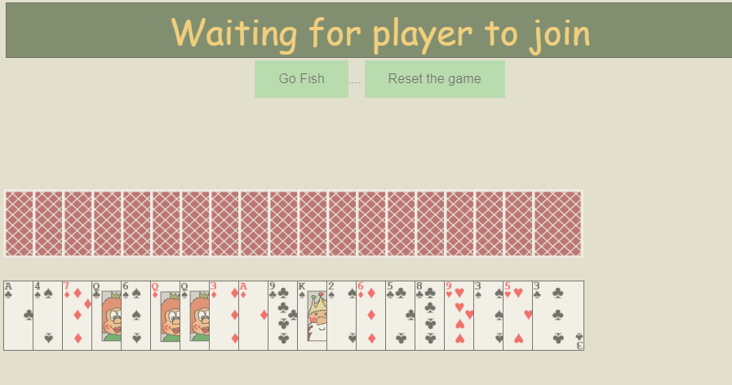
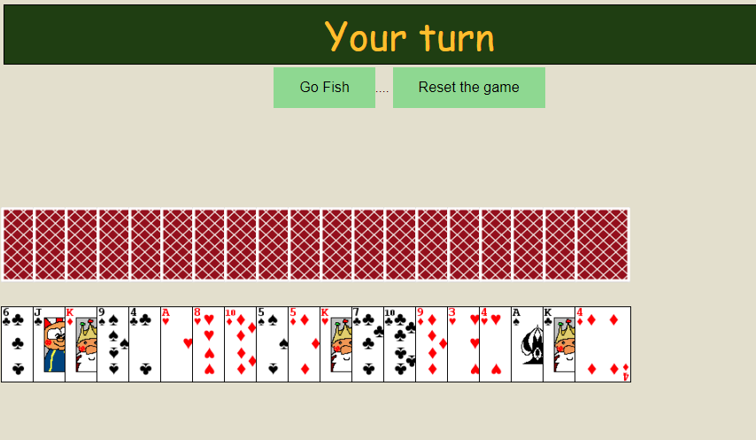
Online Mode – Go Fish
Go Fish required the most work to include an online mode
Included multiple functions and calculations to determine what to do
Issues presented themselves when calling functions of classes
Fixed by calling through server
Server needed to send correct information to players so that the program on the client side would know which operations to run and when to run them
Ex. When to ask for a card. If clicking the Go Fish button was necessary

Slide 16
Online mode Problems
A problem I encountered with the online modes was the inability to play with more than two players.
Occasionally, having two different players on the webpage could have the server crash
I corrected this by setting up different arrays for the different games.
One for the Websockets joining the game, and others for the game’s necessities.

Slide 17
Passing Information
When a player switched to the online version, their socket connection would be added to the array of sockets for that game. After the second player joined, the server would be ready for the necessities for another game, should another pair of players decide to join.
The trouble came when implementing which player to send off the data to. Depending on whether the player had an odd position, or an even position in the WebSockets array, I would have to look at the socket and player, directly to its right or it left. This became very tedious to do, because I had to set up multiple cases for how to look at different players and pass back information to different Web Sockets.

Slide 18
Heroku timing out
One main problem with Heroku was that Node would fall asleep when inactive for a short period of time
I setup a function to ping the server every few seconds. This seemed to prevent the issue.

Slide 19
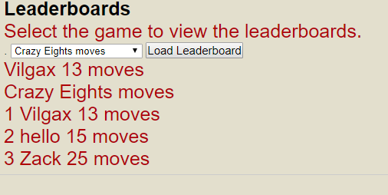
Implementing a Database
This would be used to store information about user logins and game leaderboards
User Logins:
Users could create a login with their own screenname and password
You were prevented from using a login already in existence
Game Leaderboards:
Each game stored a value for their leaderboard
The value in each leaderboard differed for each game
It did not make sense to store the same info for each game

Slide 20
Uploading to Databases
Each offline game needed a way to upload information to the database
Each presenter setup to use main Web socket connection
Upon winning, information was sent to the server
When receiving information for a database, the server would call the correct function to upload to the correct information into the correct database.

Slide 21
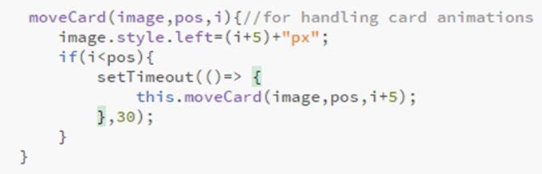
Animations
Next was to find a way to animate card movement
I wrote a series of functions that would add a card off-screen and recursively move it into place
Picture shows main recursive function
Instead of redisplaying the hand’s again, I would add a new card off-screen in the appropriate Div container.
This allowed me to only redisplay a player’s hand only when necessary.
Animations allowed for the separate viewing of the computer’s turn from the player’s when it was applicable.

Slide 22
Animations-Crazy Eights
The only necessary move was to move a card onscreen.
When a card was added to a player’s hand, it was first positioned off-screen and then moved into place
Number of cards in hand was used to determine where to stop
The pile’s display function was restructured so that the card would first be positioned off-screen, before being moved onscreen.
A delay between the computer’s and player’s turns was added so that there would be a clear animation for both

Slide 23
Animations – Snip Snap Snorum
There would be an animation when a card was added to the pile.
The computer’s coding was modified so that the player could see each card the computer played.
The player would then be modified when it was there turn again

Slide 24
Animations – Blackjack, War
The animations for these games were rather simple. All that was needed was to move a card onscreen in the right place.
Hitting the correct button would have cards move in from off-screen into the correct place.

Slide 25
Animations - Matching
The code in matching allowed for animations to occur
When clicking on a card it would actually flip over.

Slide 26
Animations – Spider Solitare
There were two animations I planned to add
Cards dropping into correct row
Cards rising up out of row to be moved from
Due to time constraints, I decided to cut the removal animation in favor of just removing the card.

Slide 27
Animations – Go Fish
This game had two major animations to manage
Adding cards to the correct player’s hand
Adding card to the list of four of a kind’s that the player has scored
When both animations played, a delay was required so that the card would reach its spot in time
Too short a delay, and the animation would be cut off
Too long a delay and the player would have too wait.

Slide 28
Animations – Online games
Some tinkering was required in order for online games to have animations as well.
Server would need to send information to users including what cards to animate and which hand to add it to.
Code on client side would use information to perform the right animation.
Restructuring server side code was tedious because of length and complexity

Slide 29
Special Thanks
Special thanks to:
Dr. Jackson for taking the time to be my mentor with my senior class project

Slide 30
Let’s visit the site now
http://cardgames-seniorproject-node.herokuapp.com/

